Slide 1
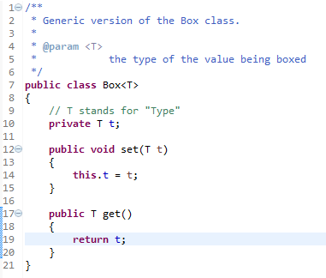
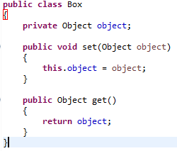
Generic Types
A generic type is a generic class or interface that is parameterized over types.
Non-generic Box class that operates on objects of any type. It needs only to provide two methods: set, which adds an object to the box, and get, which retrieves it.
Since its methods accept or return an Object, you are free to pass in whatever you want, provided that it is not one of the primitive types. There is no way to verify, at compile time, how the class is used. One part of the code may place an Integer in the box and expect to get Integers out of it, while another part of the code may mistakenly pass in a String, resulting in a runtime error.
As you can see, all occurrences of Object are replaced by T. A type variable can be any non-primitive type you specify: any class type, any interface type, any array type, or even another type variable.
This same technique can be applied to create generic interfaces.
A Simple Box Class
A Generic Version of the Box Class

Slide 2

Generic Types
To reference the generic Box class from within your code, you must perform a generic type invocation, which replaces T with some concrete value, such as Integer.
You can think of a generic type invocation as being similar to an ordinary method invocation, but instead of passing an argument to a method, you are passing a type argument — Integer in this case — to the Box class itself.
In Java SE 7 and later, you can replace the type arguments required to invoke the constructor of a generic class with an empty set of type arguments (<>) as long as the compiler can determine, or infer, the type arguments from the context. This pair of angle brackets, <>, is informally called the diamond.
Type Parameter and Type Argument Terminology: Many developers use the terms "type parameter" and "type argument" interchangeably, but these terms are not the same. When coding, one provides type arguments in order to create a parameterized type. Therefore, the T in Foo<T> is a type parameter and the String in Foo<String> f is a type argument. This lesson observes this definition when using these terms.

Slide 3
Generic Types
A generic class is defined with the this format.
The type parameter section, delimited by angle brackets (<>), follows the class name. It specifies the type parameters (also called type variables) T1, T2, ..., and Tn.
class name<T1, T2, ..., Tn>
{
/* ... */
}

Slide 4
Generic Types
By convention, type parameter names are single, uppercase letters.
Type Parameter Naming Conventions
The most commonly used type parameter names are:
E - Element (used extensively by the Java Collections Framework)
K - Key
N - Number
T - Type
V - Value
S,U,V etc. - 2nd, 3rd, 4th types

